Slide 1
AI, ML and DL
AHRC

Slide 2
Artificial Intelligence (AI) in Everyday Life
AI has been part of all aspects of our lives for a while …..
Chatbots/Virtual Assistants such as Apple Siri, Amazon Alexa
Social media Ad’s while browsing, movie/video recommendations in Netflix/YouTube
GenAI such as ChatGPT
Iris/Fingerprint recognition in mobile phones, at airports
Health monitoring system in a smart watch
Autonomous driving, airplane on autopilot
Robots/drones
AHRC

Slide 3
What is AI
AI is a software tool, a machine, robot or a device powered by computer programs that emulate the reasoning, learning, problem solving and decision making processes of humans.
Intelligent Agent
Inputs/
Percepts/
Stimulus
Sensors
AHRC
Agent
Program
Environment
Actions/
Inferences
Actuators

Slide 4
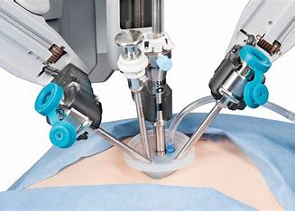
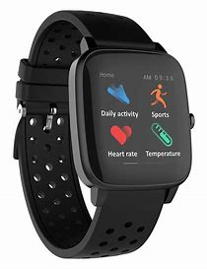
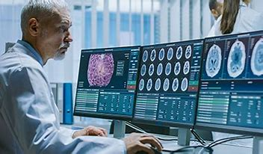
AI System Examples
 | Environment | Input/Stimuli | Action/Inference
Robotic Surgery (HW + SW) | Human Body/ Operation Theatre | Real time images/ Touch sensors/ Tool coordinates | Tool movement/ incision/cleaning
Smart Watch Health Monitor (HW + SW) | Human Wrist/ Physical activity | Motion detection/pressure sensors | Blood pressure/heart rate/calorie burn estimates
Cancer Detection Tool (SW) | Medical diagnostics database | Image and non-image medical diagnostics data | Answer: Cancer or No Cancer
and
AHRC

Slide 5
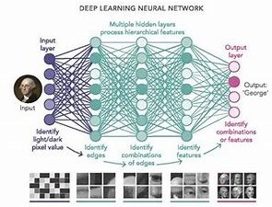
AI (Artificial Intelligence), ML (Machine Learning) and DL (Deep Learning)
AI (Artificial Intelligence): HW/SW, devices, robots, sw tools for reasoning, learning, problem solving, making inferences
AI
ML (Machine Learning): SW tools for learning from existing data and observations to make inferences and predictions on new data/observations using statistical methods
ML
DL (Deep Learning): SW tools for learning from existing data and observations to make inferences and predictions on new data/observations using Multilayer (Deep) Artificial Neural Networks
AHRC
DL

